Slide 1

Beginning Java for Android Session 1: Java—not just coffee
Izzy Johnston
izzycjohnston@gmail.com
@izzy_johnston

Slide 2


What is Java?
Programming Language developed in 1995
Platform independent
Can run on any environment once compiled
Compiling? What's that?
Translate the code you wrote into something your computer can understand

Slide 3
How does it work?
Object Oriented Programming
(or OOP to the initiated)
Objects put together to form a program
Objects contain
Data
Known as state
Behavior
Known as method

Slide 4


Think: Legos
Lego States
Color
Width
Length
Height
Stackable from the Top
Stackable from the Bottom
Lego Methods
Stack on Top
Stack Under
Stack Perpendicular
Stack Parallel
Stack Staggered

Slide 5
What happens to objects?
Small Classes
Code that create objects
Big Classes
Code that combine objects made in small classes
Library
10,000s of methods made by people
1000s of classes made by people
API (Application Programming Interface)
Rules of the library

Slide 6


Legos: Part 2
Lego Design
Designing own lego creation like creating own class
NOTE:
BOTH use the same Legos
Like using methods from from Java Library
They did not mold and cast new lego shapes.
That would be like writing own small "how to mold a lego" class.
Lego Library
Store bought set is like using a class from the Java Library

Slide 7
How to get started
Eclipse
Software Development Environment
Open Source
Mostly for Java, but you can use it for almost any language
Android SDK
Software Development Kit
Tools to develop software on a specific platform
Contains APIs and special libraries just for Android

Slide 8
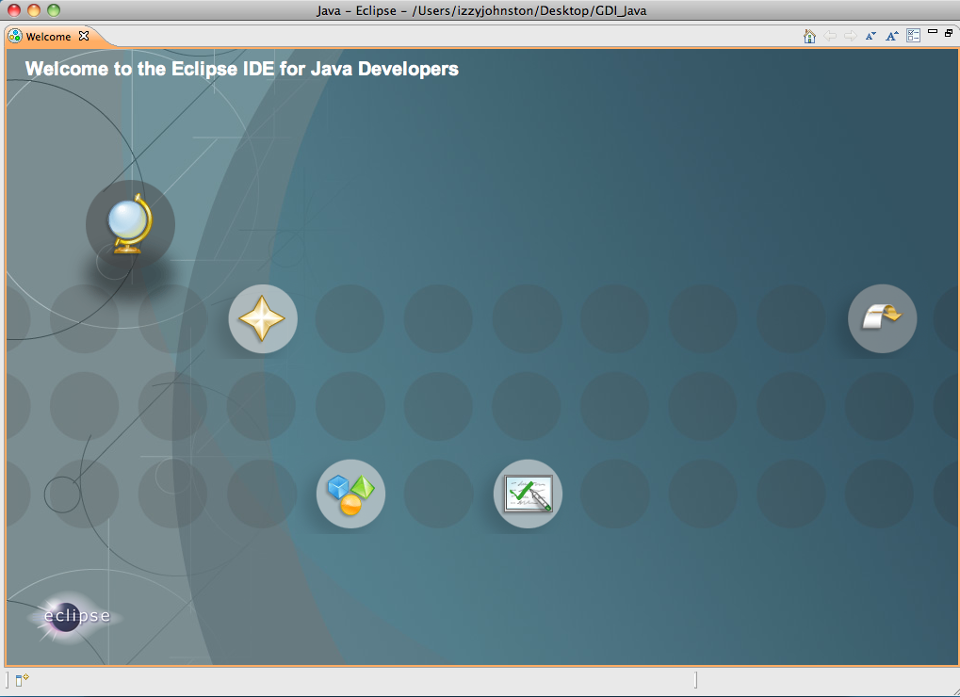
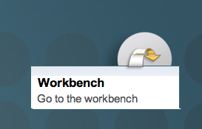

Slide 9
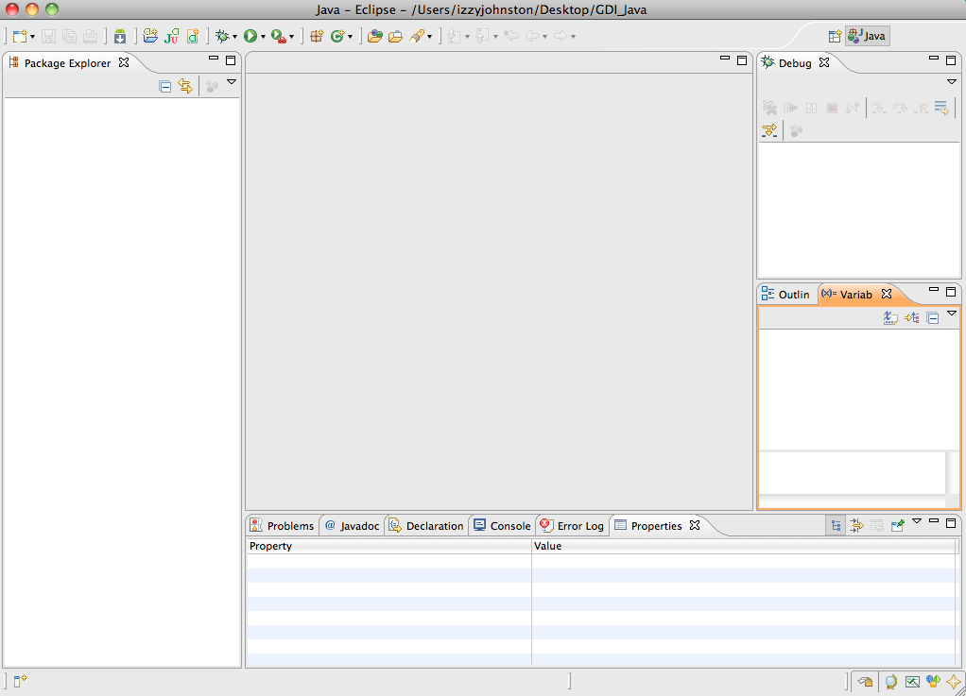

Slide 10
Variables
Chunk of content
Data (integers, strings) or Objects (Legos)
Can be local
Only used in one method
Can be global
Used anywhere in the whole program

Slide 11
Types of Variables
Integers
int, short, long
Decimals
float, double
Booleans
can be either true or false
Chars
One character
Strings
Any number of characters

Slide 12
Using Variables
"Declaring"
Saying that something is a variable
int x;
String y;
float z;
"Assigning"
Giving variables a value
x=26; OR int x=26;
y="Hi, there"; OR String y = "Hi, there";
z= 6.01; OR float z= 6.01;

Slide 13
Mathematical Operators
Symbol | Meaning | Example
+ | Addition | x + 2 = 4
- | Subtraction | x - 2= 0
* | Multiplication | x * 2 = 4
/ | Division | x / 2 = 1
% | Modulus (Remainder) | 5 % x = 1
++ | Increment | x ++ = 3
-- | Decrement | x -- = 1
*For all examples, int x=2;

Slide 14
Comparison Operators
Symbol | Meaning | Example
== | Equals? | x == y
!= | Does not equal? | x != y
> | Is greater than? | x > y
< | Is less than? | x < y
&& | AND | x<5 && y >5
|| | OR | x<5 || y >5
! | NOT | !(x>y)
*For all examples, int x=2 and int y=3

Slide 15


Slide 16
If/Else Statements
if (some parameter){
do this;
}
else {
do that;
}

Slide 17
If/Else Statements, cont.
int a=2;
int b=3;
if (a>b){
System.out.println (a);
}
else {
System.out.println (b);
}

Slide 18
If/Else Statements, cont.
int a=5;
int b=3;
if (a>b){
System.out.println (a);
}
else {
System.out.println (b);
}

Slide 19
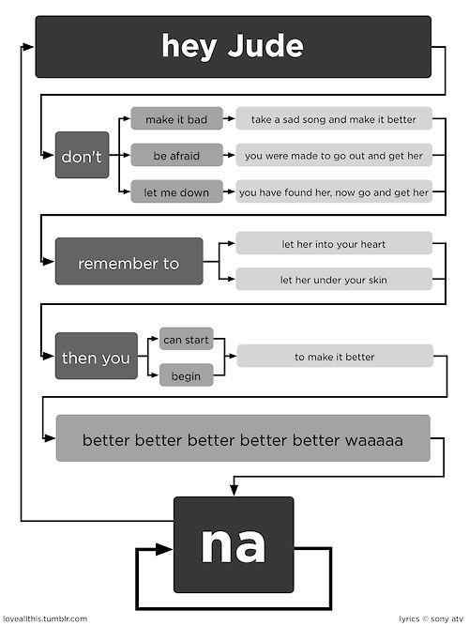

Slide 20
While Loops
int a=0;
while (a<10){
System.out.println (a);
a++;
/* OR a=a+1; */
}

Slide 21
Arrays
Holds multiple variables with index numbers instead of unique name
String [] daysOfWeek;
daysOfWeek[0] = "Sunday";
daysOfWeek[1] = "Monday";
daysOfWeek[2] = "Tuesday";
daysOfWeek[3] = "Wednesday";
daysOfWeek[4] = "Thursday";
daysOfWeek[5] = "Friday";
daysOfWeek[6] = "Saturday";

Slide 22
For Loop
Like the while loop but with counting
for (int i=0; i<7; i++){
System.out.println (daysOfWeek[i]+ ", ");
}

Slide 23
For Loop…a more practical example
int [] randomNumbers;
for (int i=0; i<100; i++){
randomNumbers[i] =
(int)(Math.random()*10)+1;
}

Slide 24
Making a Class
Every application has at least one class
public class ClassName{
class body;
}

Slide 25
Making a Method
Every application has at least one method
public static void methodName (arguments) {
method body;
}

Slide 26
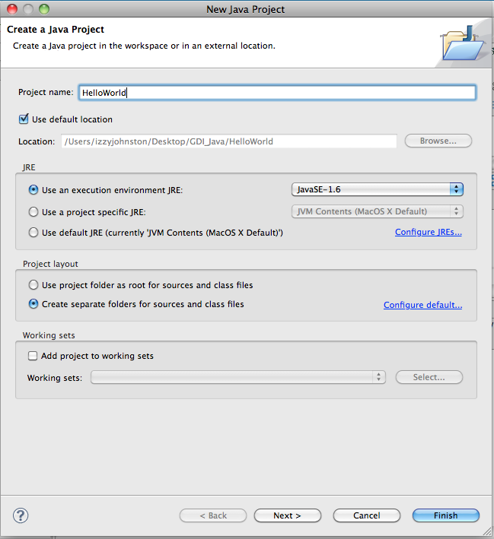
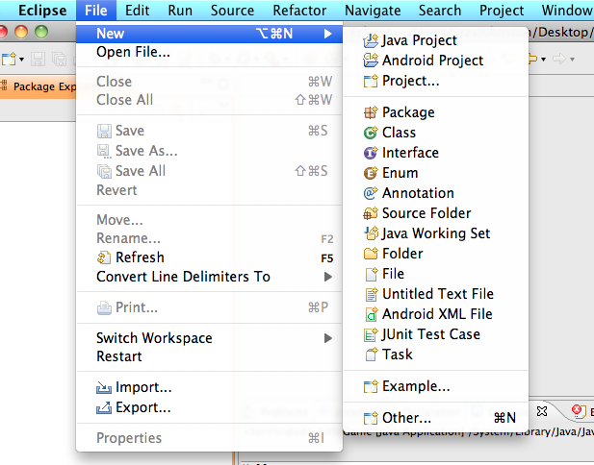
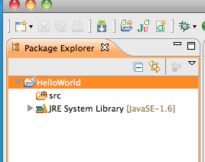

Slide 27
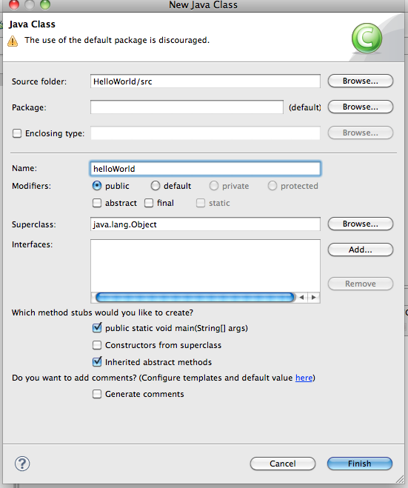
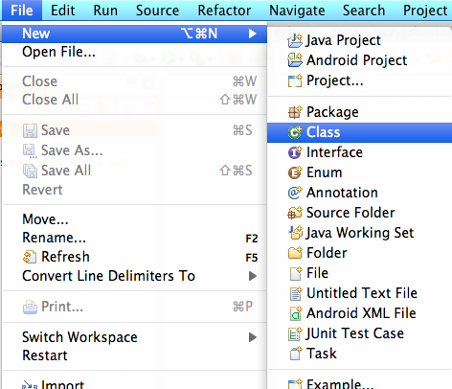

Slide 28
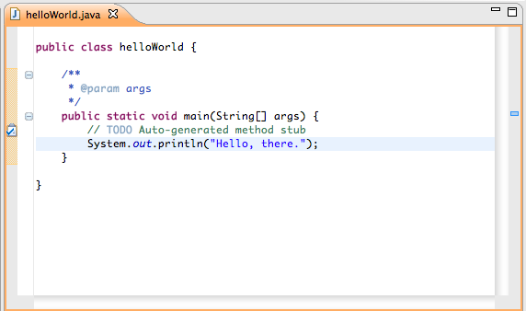

Slide 29
Math Class
Name | What it does | Parameters | Example | Result
absolute value | Absolute Value of your number | One Number | Math.abs(-35); | 35
random | Generates number between 0.0 and 0.9 | None | Math.random()*6; | Number between 0 and 5
Maximum | Returns bigger of two number | Two numbers | Math.max(35, 72); | 72
Minimum | Returns smaller of two numbers | Two numbers | Math.min(35, 72); | 35
Power | Returns first number to power of second | Two numbers | Math.pow(10, 3); | 1000
Square Root | Returns Square root of number | One number | Math.sqrt(16); | 4

Slide 30
Lotto Game
Goal: Guess the number randomly generated by the computer
Step 1. Create new Java Project named LottoGame
Step 2: Create new Java Class name lottoGame

Slide 31
Lotto Game, cont.
Importing—letting the program we want to use a class from the Java API
Written above the class declaration
import java.lang.Math;
import java.util.Scanner;

Slide 32
Lotto Game, cont.
Declare three variables.
Inside method.
int guess;
int answer;
Scanner sc = new Scanner(System.in);

Slide 33
Lotto Game, cont.
System.out.println("Guess a number between 1 and 6");
guess = sc.nextInt();
answer = (int)(Math.random()*6+1);
if (guess==answer) {
System.out.println("Congratulations! You guessed right!");
}
else {
System.out.println("Sorry, that wasn't right. The correct answer was " + answer+".");
}

Slide 34
String Operators
Name | What it does | Parameters | Example | Result
Compare To | Compares two strings | Compares two strings | String.compareTo("cat", "cats"); | 0
Length | Tells you length of a string | One string | String.length("pickles"); | 7
toString | Turns a number into a string | Any number (int, float, double) | Integer.toString(72); | "72"
Parse | Turns string into number | A string known to only contain numbers | Integer.parseInt("72"); | 72
Replace | Replaces a character with another | Two characters | "Happy".replace ('a', 'o'); | Hoppy
toCharArray | Splits string into array of characters | None | char myArray[]="Hey".toCharArray(); | myArray[0]='H'; myArray[1]='e'; myArray[2]='y';

Slide 35
Homework: String Scrambler
Using the String operators and a for loop
Build an application that prints the letters in a word backward
Hints:
Get a String from the scanner using .next()
Split the string into an array.
Print out the array in backward order
Bonus:
Try to use Math.random() to print out the array in random order
There are completed versions of HelloWorld, LottoGame, and StringScrambler in the practice files

Slide 36
Questions?
?

